Slide 1
QMST 5335 – FORECASTING AND SIMULATION Introduction to Forecasting by Dincer Konur
Department of Computer Information Systems and Quantitative Methods McCoy College of Business Administration Texas State University

Slide 2
Learning Objectives:
Understanding the Basics of Forecasts and Forecasting (FPP Chapter 1)
What are forecasts? Forecasting planning (FPP Chapter 1)
Characteristics of forecasts (not directly in the FPP book)
Forecasting methods overview (not directly in the FPP book)
Learning some Simple Forecasting Methods (FPP Chapter 5.2)
Understanding Judgmental and Simulation Forecasting (FPP Chapter 6)
What are the judgmental methods? Why and when?
Brief overview of some judgmental methods
How simulation can be used for forecasting? Why and when?
Understanding the basics of Time Series Forecasting (FPP Chapter 2.3)
Time series characteristics
Basic components in time series forecasting (FPP Chapter 3.2)

Slide 3
Outline
Introduction to Forecasting (FPP Chapter 1)
Simple Forecasting Methods (FPP Chapter 5.2)
Judgmental and Simulation Forecasting (FPP Chapter 6)
Introduction to Time Series Forecasting (FPP Chapter 2.3&3.2)
Review and Homework 1 Overview
Online Videos
Live Session

Slide 4
Outline – Online Video #1
Introduction to Forecasting (FPP Chapter 1)
Simple Forecasting Methods (FPP Chapter 5.2)
Judgmental and Simulation Forecasting (FPP Chapter 6)
Introduction to Time Series Forecasting (FPP Chapter 2.3&3.2)
Review and Homework 1 Overview

Slide 5
Introduction to Forecasting
Forecasting is about predicting the future as accurately as possible
It accounts for all of the information available, including historical data and knowledge of any future events that might impact the forecasts.
Forecasting is required in many situations:
Deciding whether to build another power generation plant in the next five years requires forecasts of future demand
Scheduling staff in a call center next week requires forecasts of call volumes
Stocking an inventory requires forecasts of stock requirements
Demand forecasting forms the basis for all planning decisions in a supply chain
Goals are what you would like to have happen.
Goals should be linked to forecasts and plans
Planning is a response to forecasts and goals.
Planning involves determining the appropriate actions that are required to make your forecasts match your goals.

Slide 6
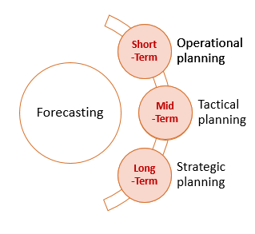
Introduction to Forecasting
Time horizon in forecasting:
Short-term forecasting (days/weeks)
Used for short-term operational planning
Such as inventory management, material requirements planning, scheduling of personnel, production and transportation.
Intermediate-term forecasting (weeks/months)
Needed to determine future resource requirements, in order to purchase raw materials, hire personnel, or buy machinery and equipment.
Used for sales patterns, resource requirements, labor management
Long-term forecasting (months/years)
Used in strategic planning. Such decisions must take account of market opportunities, environmental factors and internal resources.
Capacity management, long-term production planning

Slide 7
Introduction to Forecasting
Characteristics of forecasts:
Forecasts are always inaccurate and should thus include both the expected value of the forecast and a measure of forecast error
Long-term forecasts are usually less accurate than short-term forecasts
Predicting the further future is more difficult!
Aggregate forecasts are usually more accurate than disaggregate forecasts
Forecasting the demand for Large-brown pants vs. forecasting the demand for Large-pants
A good forecasting is:
Timely and in meaningful units
Reliable and as accurate as possible
Easily determined and documented

Slide 8
Introduction to Forecasting
Forecasting task:
Problem Definition: Why needed? Who will use them? For what? What will be the effects of forecasts?
Gather information: Collect all the data! Statistical data and input from experts. Know the dynamics!
Preliminary analyses: Analyze the data, observe patterns (trends, cycles, etc.)
Choose the method: Depending on the data and the dynamics, compare couple of methods, and select a final method to use.
Use and evaluate: Use the method and evaluate it continuously (check the accuracy as new information becomes available), make changes in the method specifications as need (or maybe change the method)

Slide 9
Introduction to Forecasting
Forecasting methods overview:
Judgmental methods: Subject to judgement
When there is not much data
Simulation (Scenario-based) method:
When there is not much data, generate data using simulation
Time Series Methods
Use historical data (time series)
Casual Methods
Use historical data and/or other factors
Also, there are other simple forecasting approaches

Slide 10
Outline – Online Video #2
Introduction to Forecasting (FPP Chapter 1)
Simple Forecasting Methods (FPP Chapter 5.2)
Judgmental and Simulation Forecasting (FPP Chapter 6)
Introduction to Time Series Forecasting (FPP Chapter 2.3&3.2)
Review and Homework 1 Overview

Slide 11

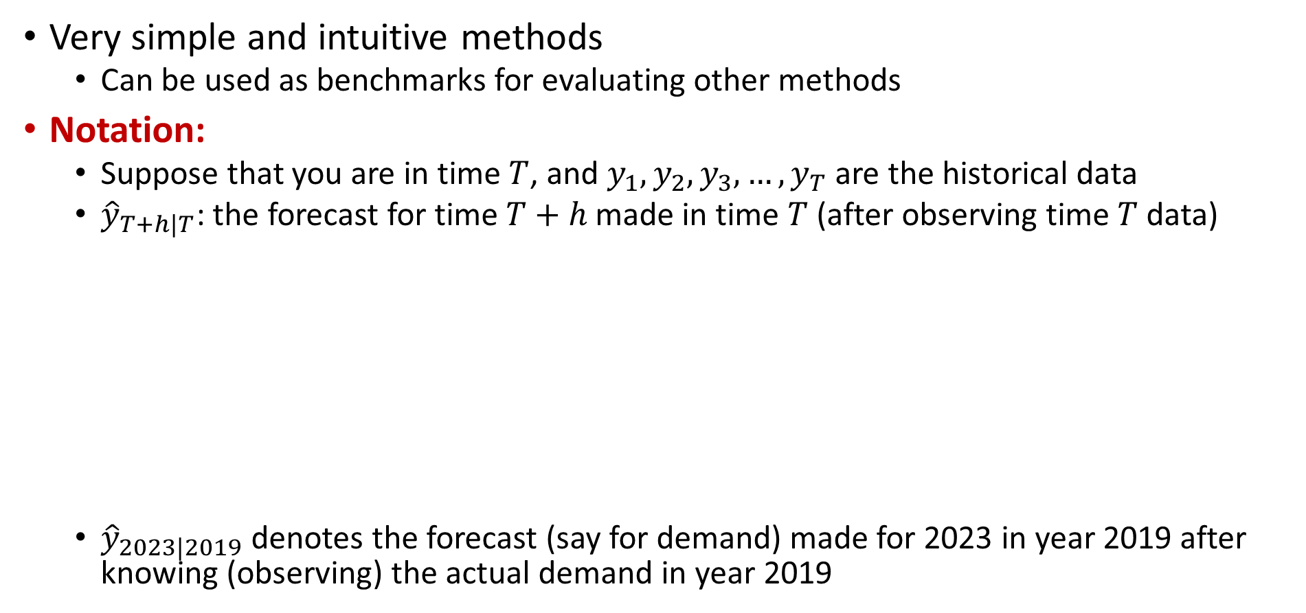
Simple Forecasting Methods
Very simple and intuitive methods
Can be used as benchmarks for evaluating other methods
Notation:
Suppose that you are in time $T$, and $y_{1},y_{2},y_{3}, …,y_{T}$ are the historical data
${\hat{y}}_{T+h|T}$: the forecast for time $T+h$ made in time $T$ (after observing time $T$ data)
${\hat{y}}_{2023|2019}$ denotes the forecast (say for demand) made for 2023 in year 2019 after knowing (observing) the actual demand in year 2019
^ over a variable is used to denote a forecast value. No hat means the observed value
$${\hat{y}}_{T+h|T}$$
When you are making the forecast
For which time, you are making the forecast

Slide 12



Simple Forecasting Methods
Average Method: the forecasts of all future values are equal to the average (or “mean”) of the historical data.
For any h:
Naïve Method: set all forecasts to be the value of the last observation
For any h:
Seasonal Naïve Method: set each forecast to be equal to the last observed value from the same season of (e.g., the same month of the previous year).
For any h:
where m= the seasonal period, and k is the integer part of (h−1)/m (i.e., the number of complete years in the forecast period prior to time T+h). For example:
With monthly data, the forecast for all future May values is equal to the last observed May value.
With quarterly data, the forecast of all future Q2 values is equal to the last observed Q2 value

Slide 13

Simple Forecasting Methods
Drift Method: A variation on the naïve method is to allow the forecasts to increase or decrease over time, where the amount of change over time (called the drift) is set to be the average change seen in the historical data.
This is equivalent to drawing a line between the first and last observations, and extrapolating it into the future.
This is the average difference

Slide 14
Simple Forecasting Methods
A small example (not in the textbook):
See ‘Simple Forecasting Methods – Example.xlsx’ file.
Other examples: See FPP Chapter 5.2.

Slide 15
Outline – Online Video #3
Introduction to Forecasting (FPP Chapter 1)
Simple Forecasting Methods (FPP Chapter 35.2)
Judgmental and Simulation Forecasting (FPP Chapter 6)
Introduction to Time Series Forecasting (FPP Chapter 2.3&3.2)
Review and Homework 1 Overview

Slide 16
Judgmental and Simulation Forecasting
Forecasting using judgement is common in practice.
There are no available data, so that statistical methods are not applicable and judgmental forecasting is the only feasible approach;
No data, incomplete data, delayed data
Data are available, statistical forecasts are generated, and these are then adjusted using judgement;
Data are available and statistical and judgmental forecasts are generated independently and then combined.
Judgmental forecasts are:
Subjective, so not unbiased
Can be inconsistent as they heavily depend on someone’s perception
Based on a person’s own experiences
Be systematic:
Define the task clearly, use data as much as possible, formalize and justify, evaluate
Read FPP Chapter 6.2 (PBS Example)

Slide 17
Judgmental and Simulation Forecasting
Some judgmental forecasting methods:
Delphi method: The method relies on the key assumption that forecasts from a group are generally more accurate than those from individuals. The aim of the Delphi method is to construct consensus forecasts from a group of experts in a structured iterative manner.
A panel of experts is assembled.
Forecasting tasks/challenges are set and distributed to the experts.
Experts return initial forecasts and justifications. These are compiled and summarized in order to provide feedback.
Feedback is provided to the experts, who now review their forecasts in light of the feedback. This step may be iterated until a satisfactory level of consensus is reached.
Final forecasts are constructed by aggregating the experts’ forecasts.
Forecasting by analogy: Thinking and discussing analogous products or situations can generate useful (and sometimes crucial) information.
A common example is the pricing of a house through an appraisal process
Structure analogy: similar to Delphi method, but ask experts to use analogy.

Slide 18
Judgmental and Simulation Forecasting
Simulation can be used for forecasting as well
Scenario forecasting: generate forecasts based on plausible scenarios. Building forecasts based on scenarios allows a wide range of possible forecasts to be generated and some extremes to be identified. With scenario forecasting, decision makers often participate in the generation of scenarios
Simulation can be considered to create scenarios (simulate scenarios)
Imitate consumer choices that give rise to demand
Might use previous data as well as expert input
Further reading:
New product forecasting (FPP Chapter 6.6)
Forecasting methods for new product adoption/demand (search online: Bass Forecasting Method)
http://www.bassbasement.org/BassModel/Default.aspx
https://en.wikipedia.org/wiki/Bass_diffusion_model

Slide 19
Outline – Online Video #4
Introduction to Forecasting (FPP Chapter 1)
Simple Forecasting Methods (FPP Chapter 5.2)
Judgmental and Simulation Forecasting (FPP Chapter 6)
Introduction to Time Series Forecasting (FPP Chapter 2.3&3.2)
Review and Homework 1 Overview

Slide 20
Time Series Forecasting
The forecast of the variable being predicted only depends on the past values of the variable, i.e., the time series
The idea is that the variable can be forecasted using past observations of the variable
Need to be careful about the patterns of the past data
Trend: a stable pattern of growth or decline
A trend exists when there is a long-term increase or decrease in the data.
It does not have to be linear.
Seasonality: a pattern repeating at fixed intervals
A seasonal pattern occurs when a time series is affected by seasonal factors such as the time of the year or the day of the week.
Seasonality is always of a fixed and known frequency.
Cycles: similar to seasonality but length and magnitude of the cycle may vary
A cycle occurs when the data exhibit rises and falls that are not of a fixed frequency.
Different than seasonality!
Randomness (stationary): no recognizable pattern

Slide 21
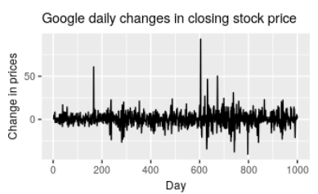
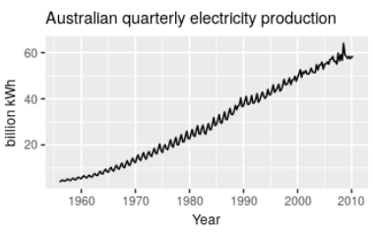
Time Series Forecasting
Examples of time series with different characteristics:
The daily change in the Google closing stock price has no trend, seasonality or cyclic behavior. There are random fluctuations which do not appear to be very predictable, and no strong patterns that would help with developing a forecasting model.
The Australian quarterly electricity production shows a strong increasing trend, with strong seasonality. There is no evidence of any cyclic behavior here.

Slide 22
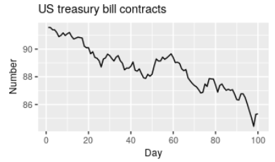
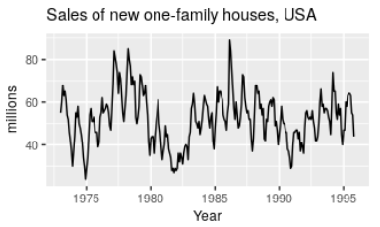
Time Series Forecasting
Examples of time series with different characteristics:
The US treasury bill contracts show results from the Chicago market for 100 consecutive trading days in 1981. Here there is no seasonality, but an obvious downward trend.
The monthly housing sales show strong seasonality within each year, as well as some strong cyclic behavior with a period of about 6–10 years. There is no apparent trend in the data over this period.

Slide 23
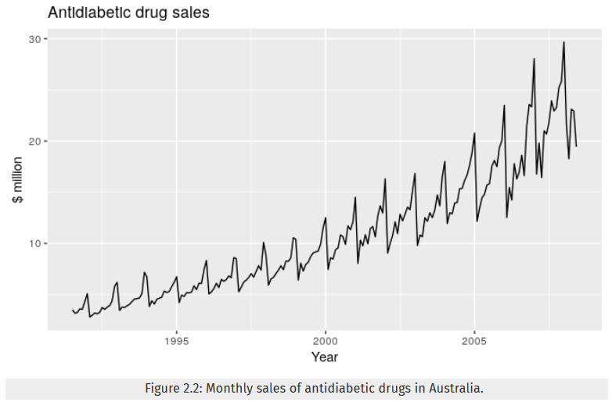
Time Series Forecasting
Examples of time series with different characteristics:
Here, there is a clear increasing trend. There is also a strong seasonal pattern that increases in size as the level of the series increases.

Slide 24
Time Series Forecasting
In time series, a data point will typically consist of:
Systematic component (S) – expected value
Level (current de-seasonalized demand)
Trend (growth or decline in demand)
Seasonality (predictable seasonal fluctuation)
Random component – part of forecast that deviates from the systematic part
Three ways to calculate the systematic component
Multiplicative → S = level x trend x seasonal factor
Additive → S = level + trend + seasonal factor
Mixed → S = (level + trend) x seasonal factor
Used in calculating the forecasts!

Slide 25
Time Series Forecasting
Depending on the patterns in the data, the suitable forecasting method changes, therefore, it is important to visualize and analyze the data before starting applying a method
Read FPP ‘Chapter 2 – Time Series Graphics’ for different visualization tools
Time series forecasting methods:
Moving Average Method
Exponential Smoothing Method
Holt’s Linear Trend Method
Holt-Winters’ Seasonal Method
Suitable for time series without trends and seasonality
Suitable for time series with trend but not seasonality
Suitable for time series with trend and seasonality

Slide 26
Outline – Live Session
Introduction to Forecasting (FPP Chapter 1)
Simple Forecasting Methods (FPP Chapter 3.1)
Judgmental and Simulation Forecasting (FPP Chapter 4)
Introduction to Time Series Forecasting (FPP Chapter 2.3)
Review and Homework 1 Overview

Slide 27
Review
Basics of forecasts and forecasting
Importance of time horizon
Characteristics of forecasts
Forecasting planning
Simple forecasting methods
Average, Naïve, Seasonal Naïve, and Drift methods
Judgmental and Simulation Forecasting
When to use?
Characteristics of judgmental forecasts
Delphi method and forecasting by analogy
Introduction to Time Series Forecasting
Characteristics of time series
Basic components of time series forecasting

Slide 28
Homework 1 Overview
Overview of Homework 1

